Slide 1
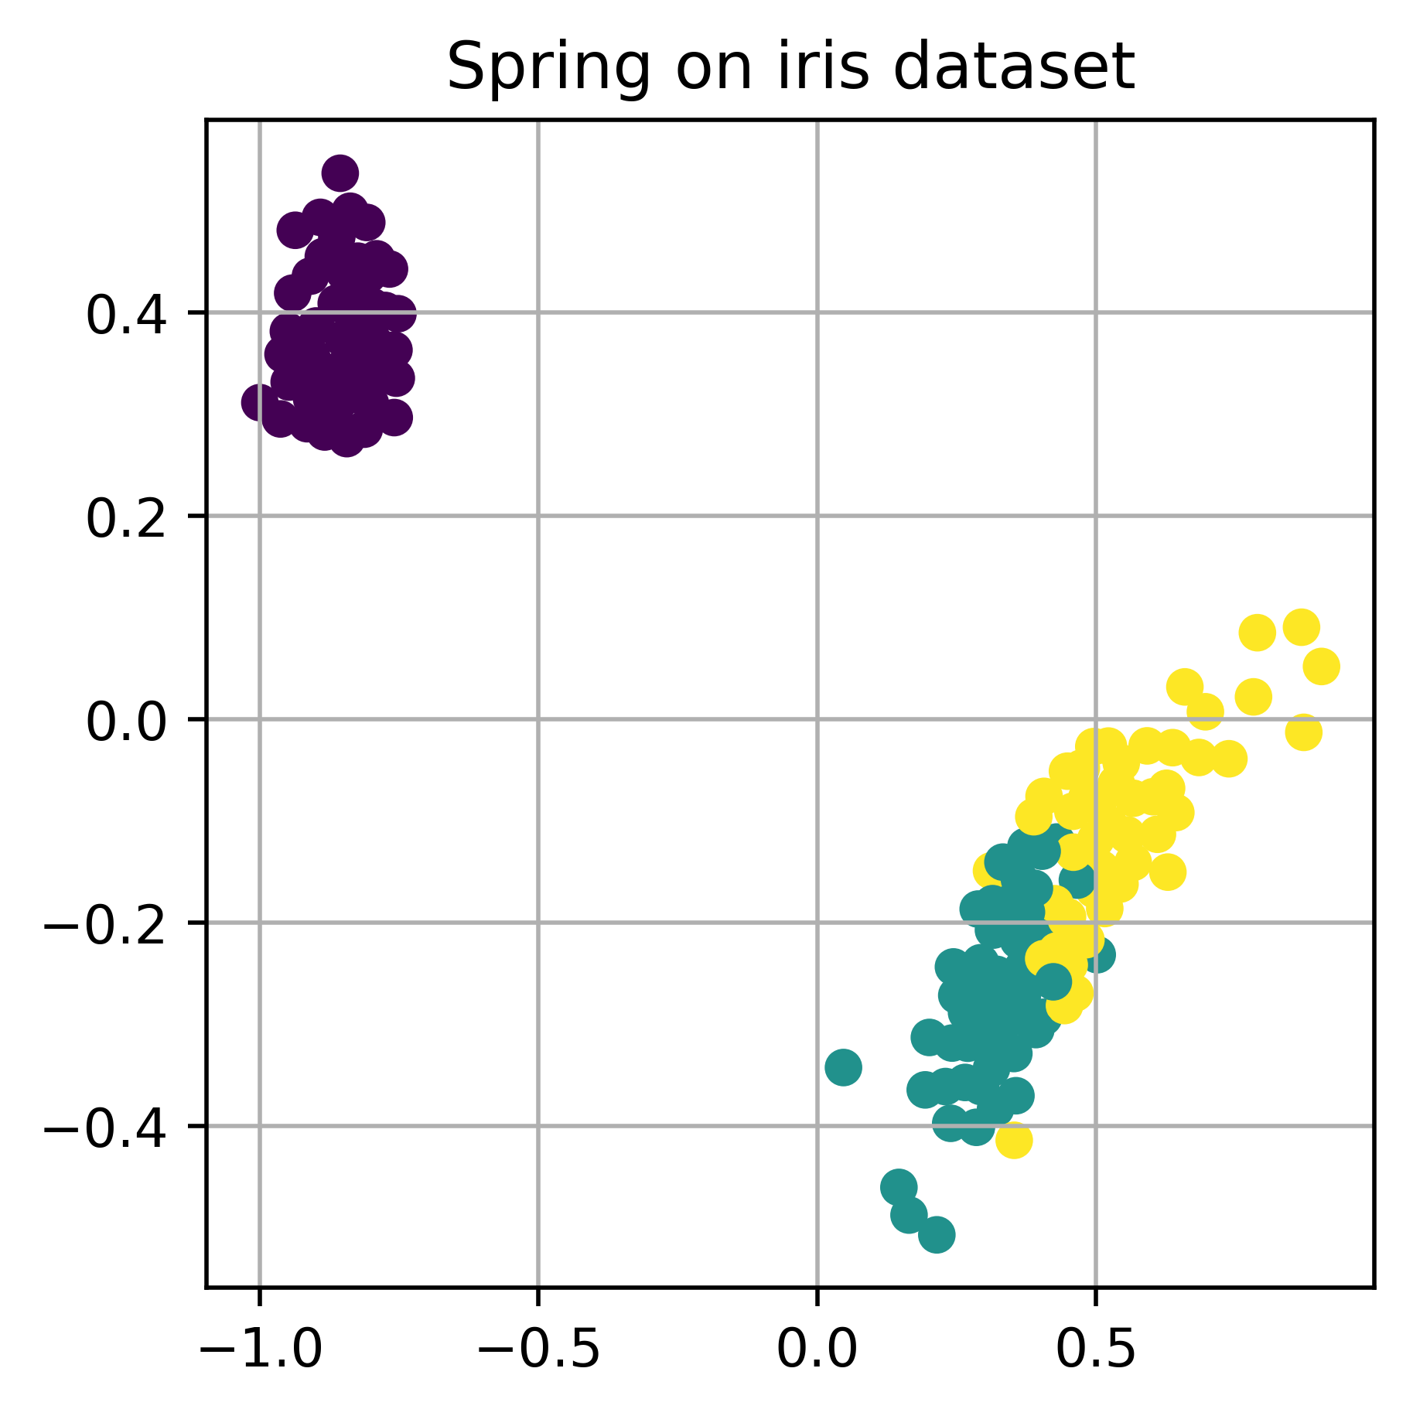
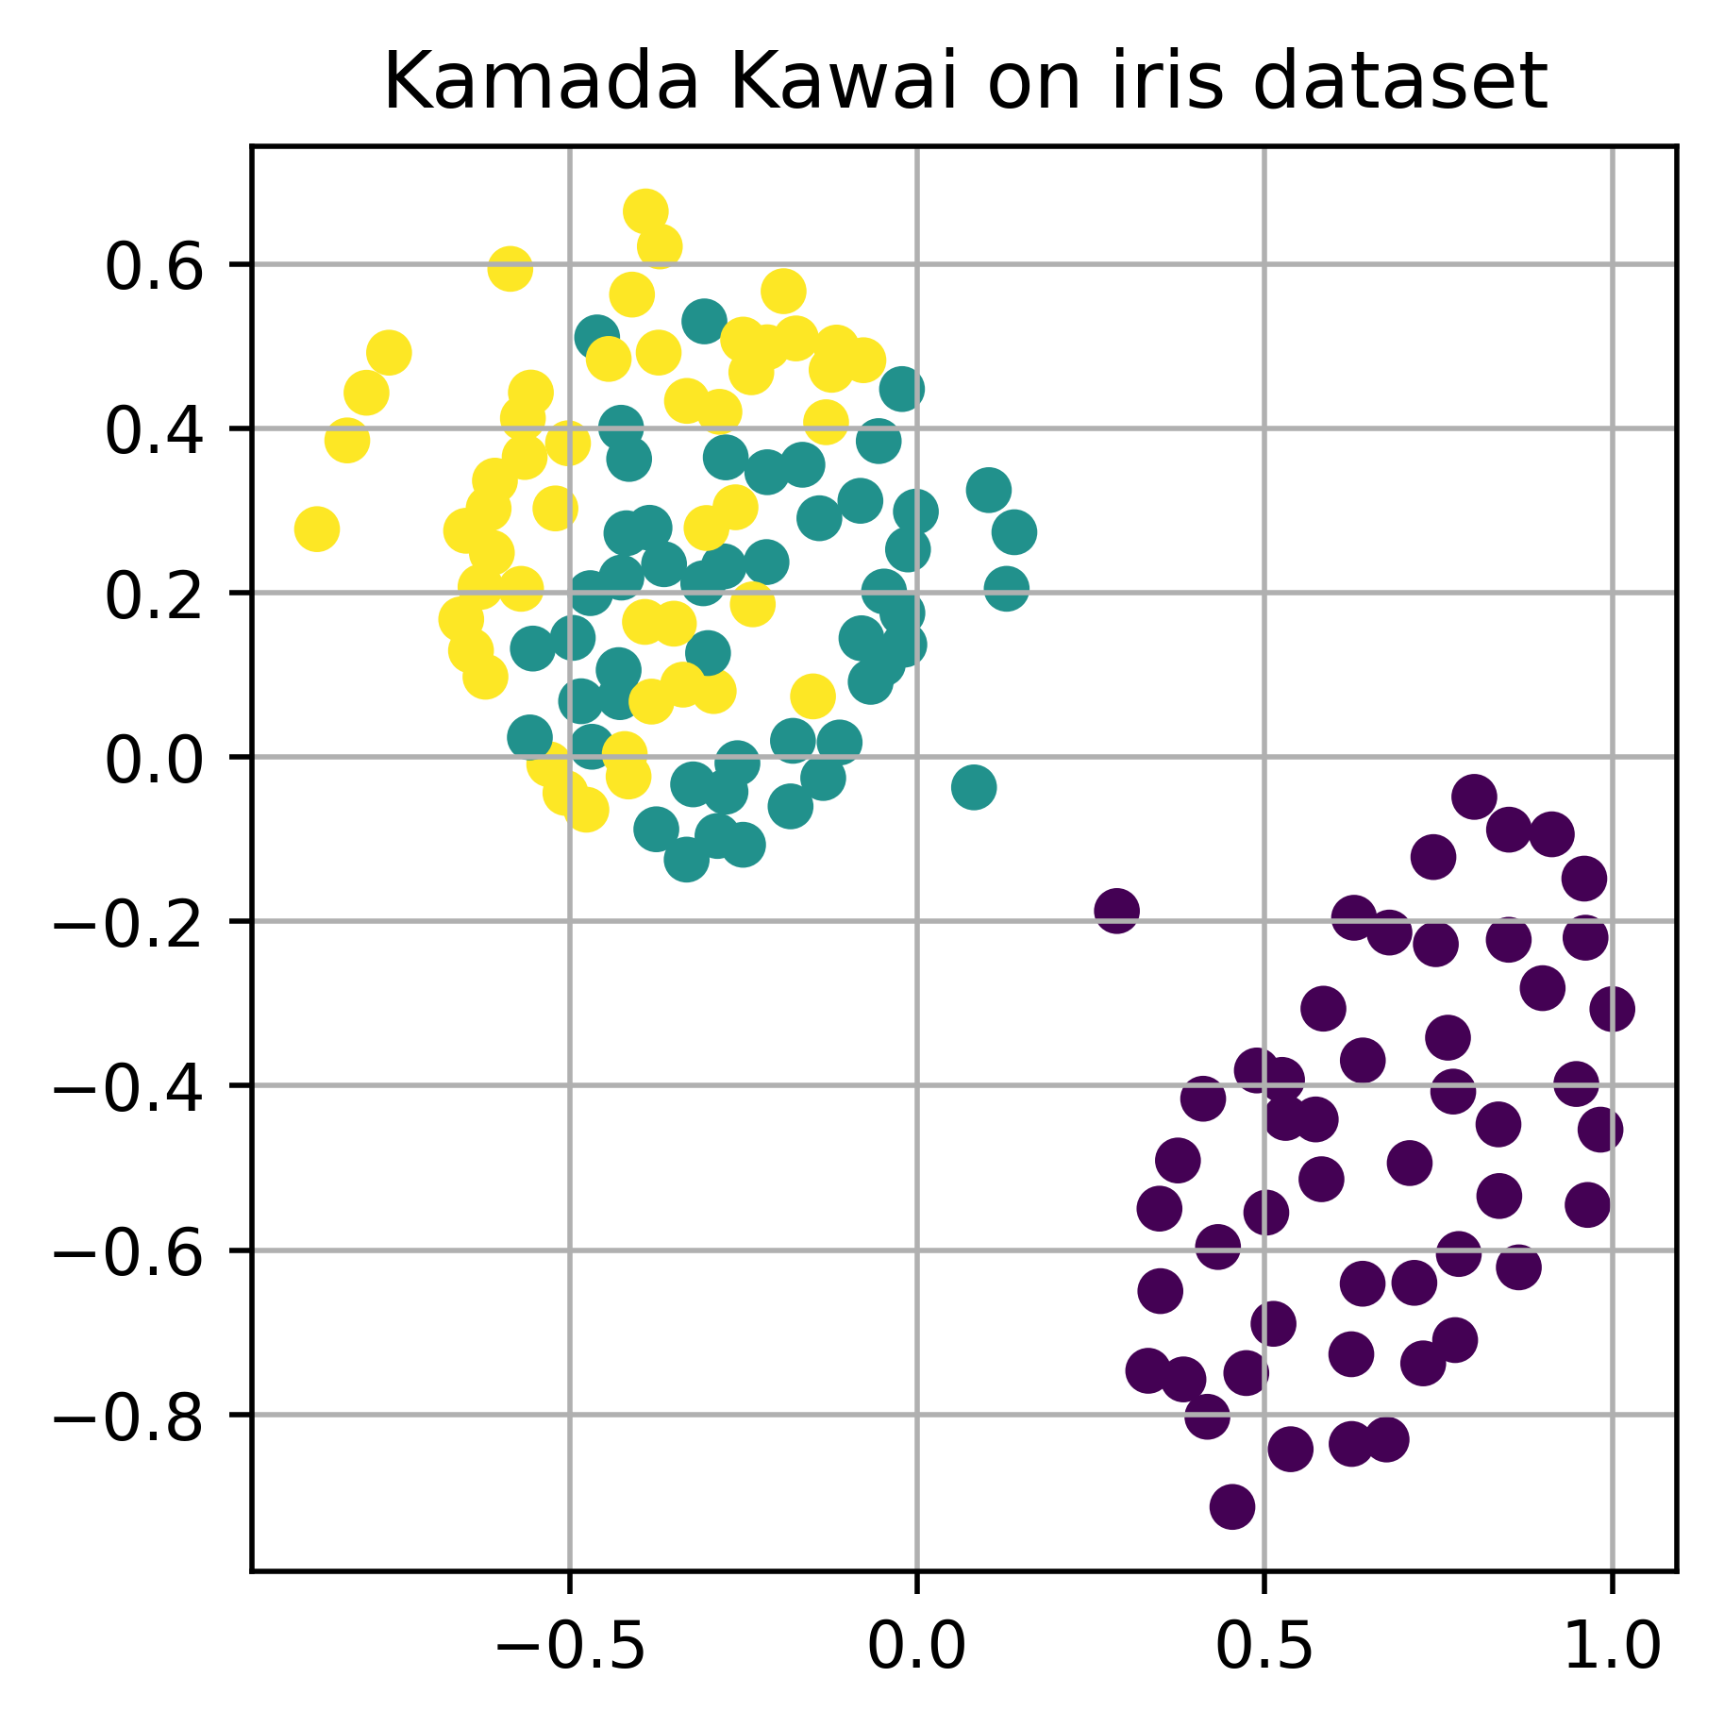
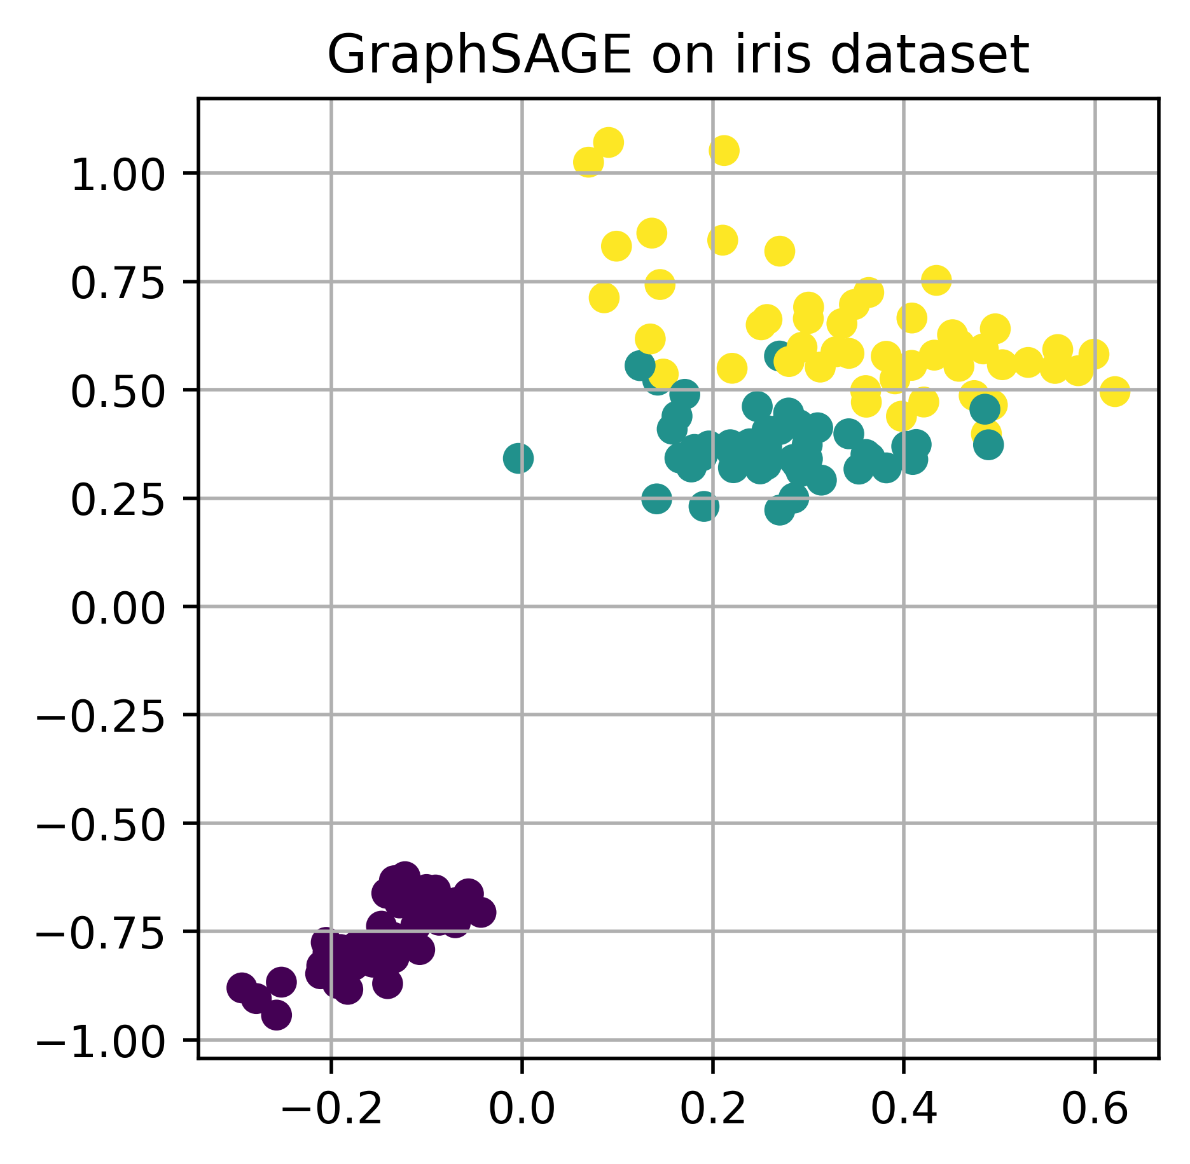
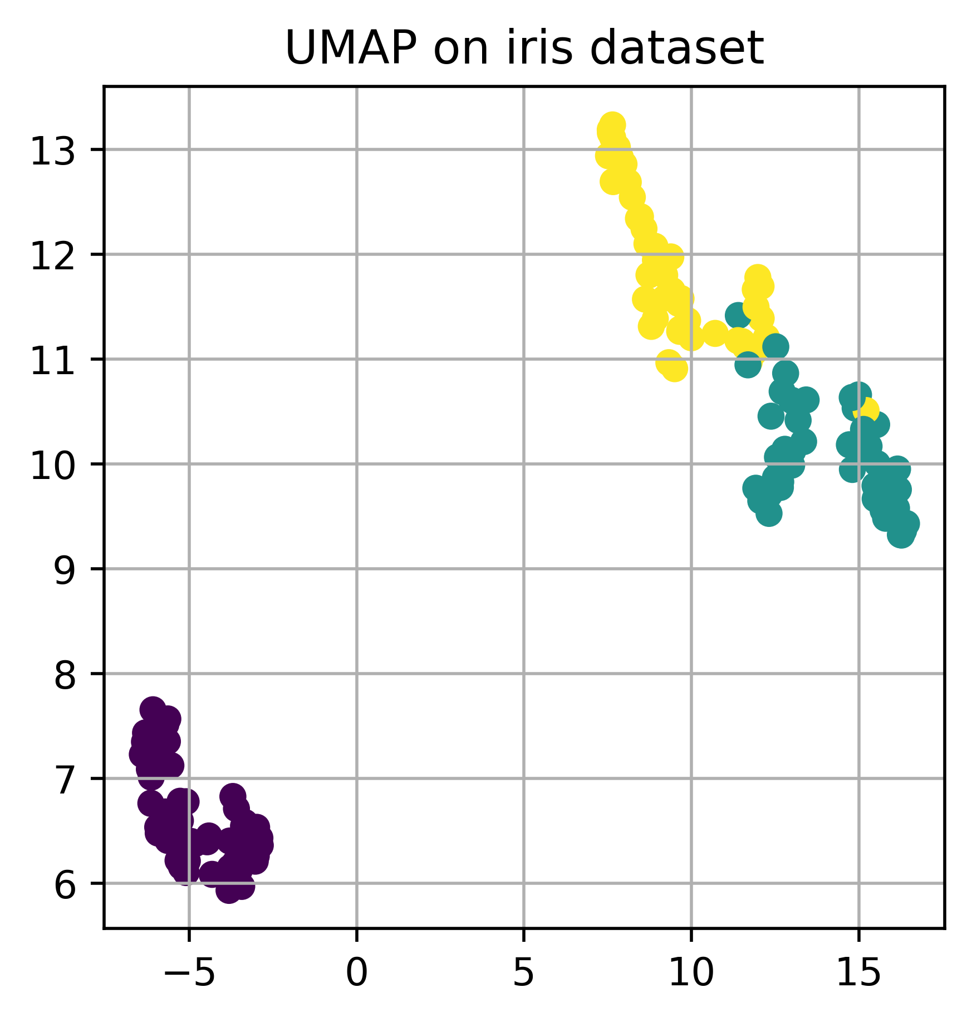
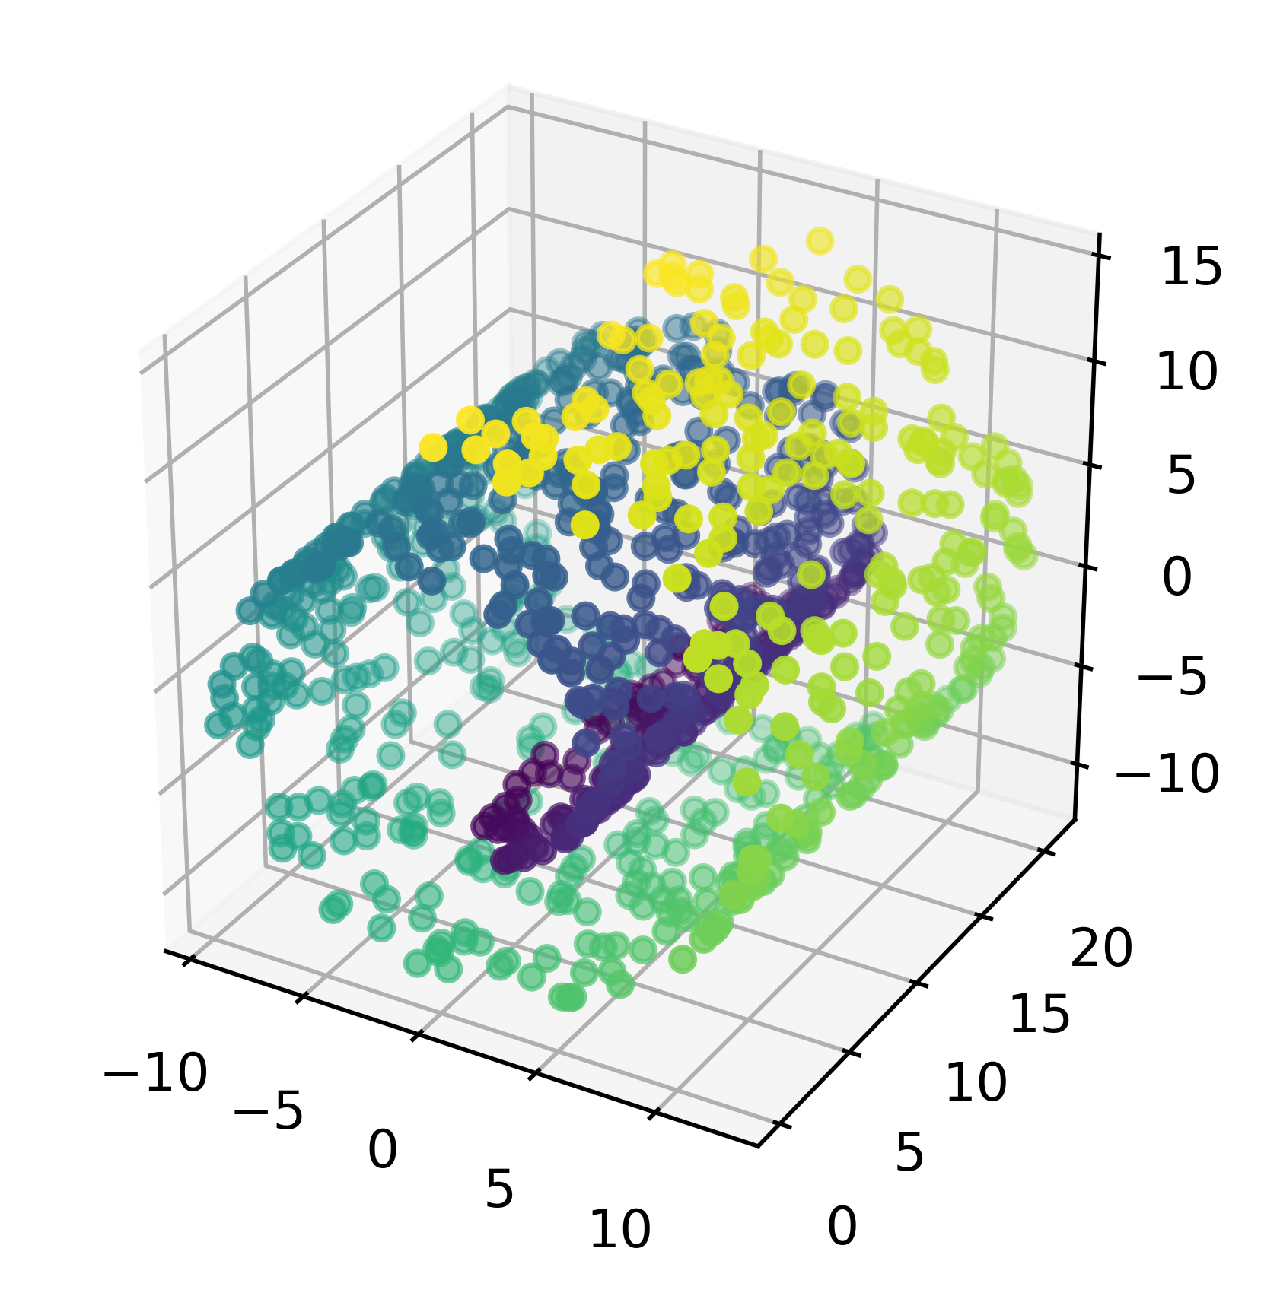
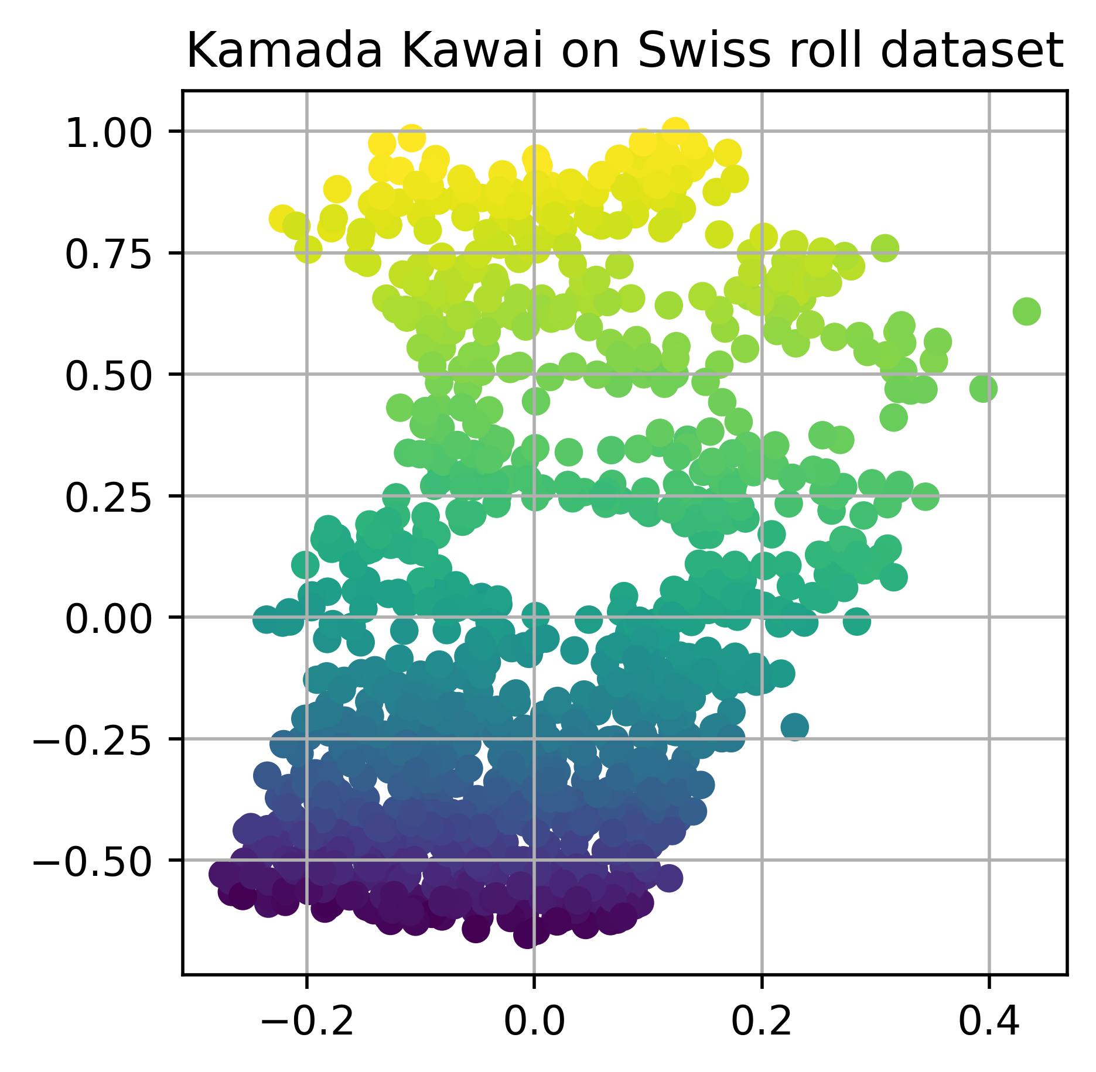
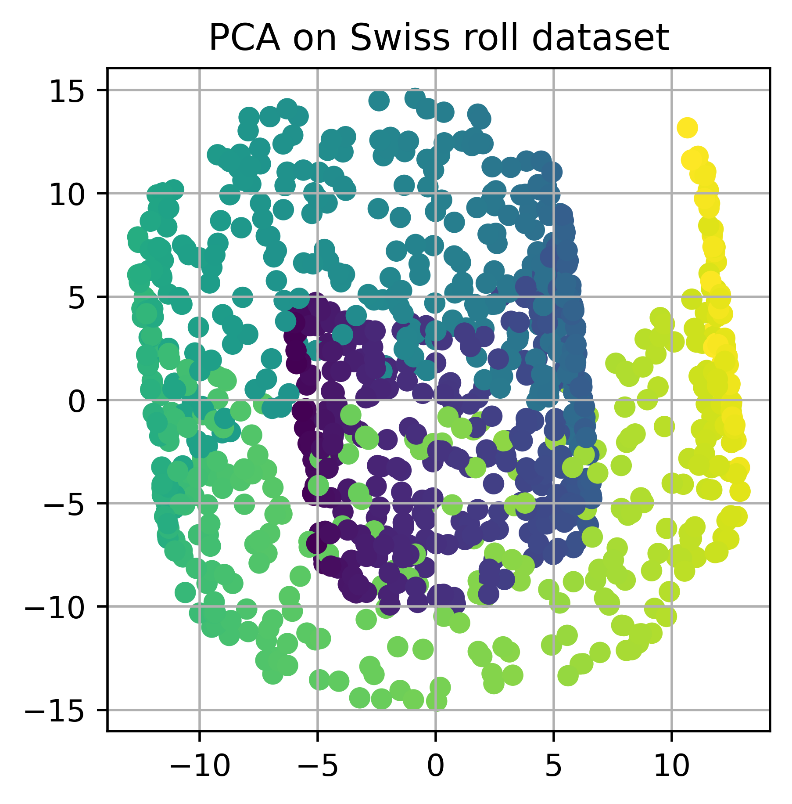
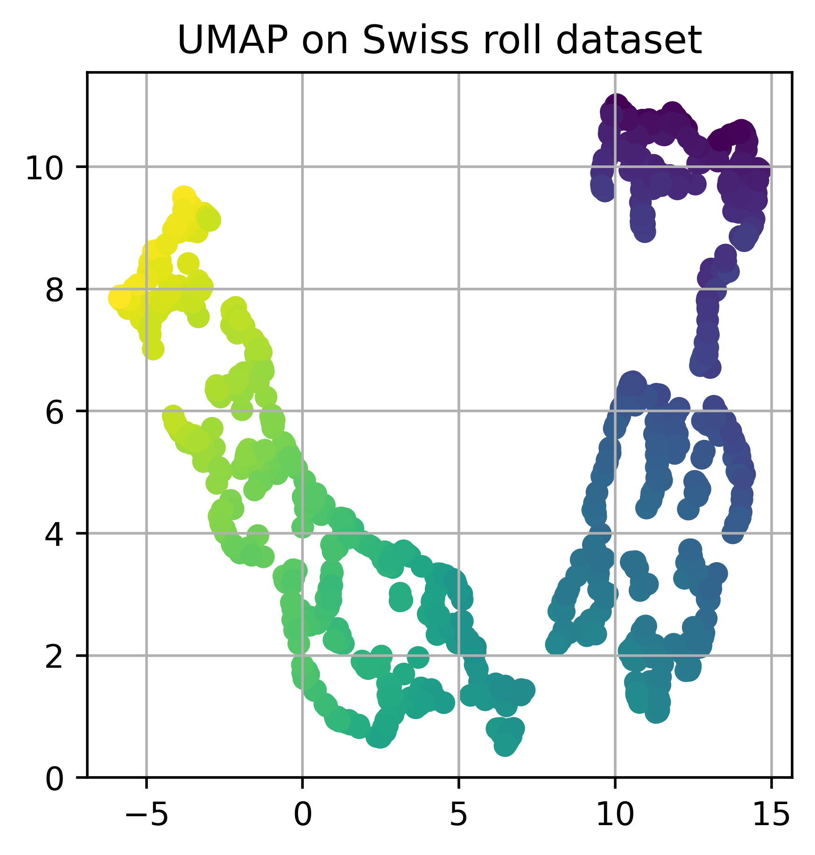
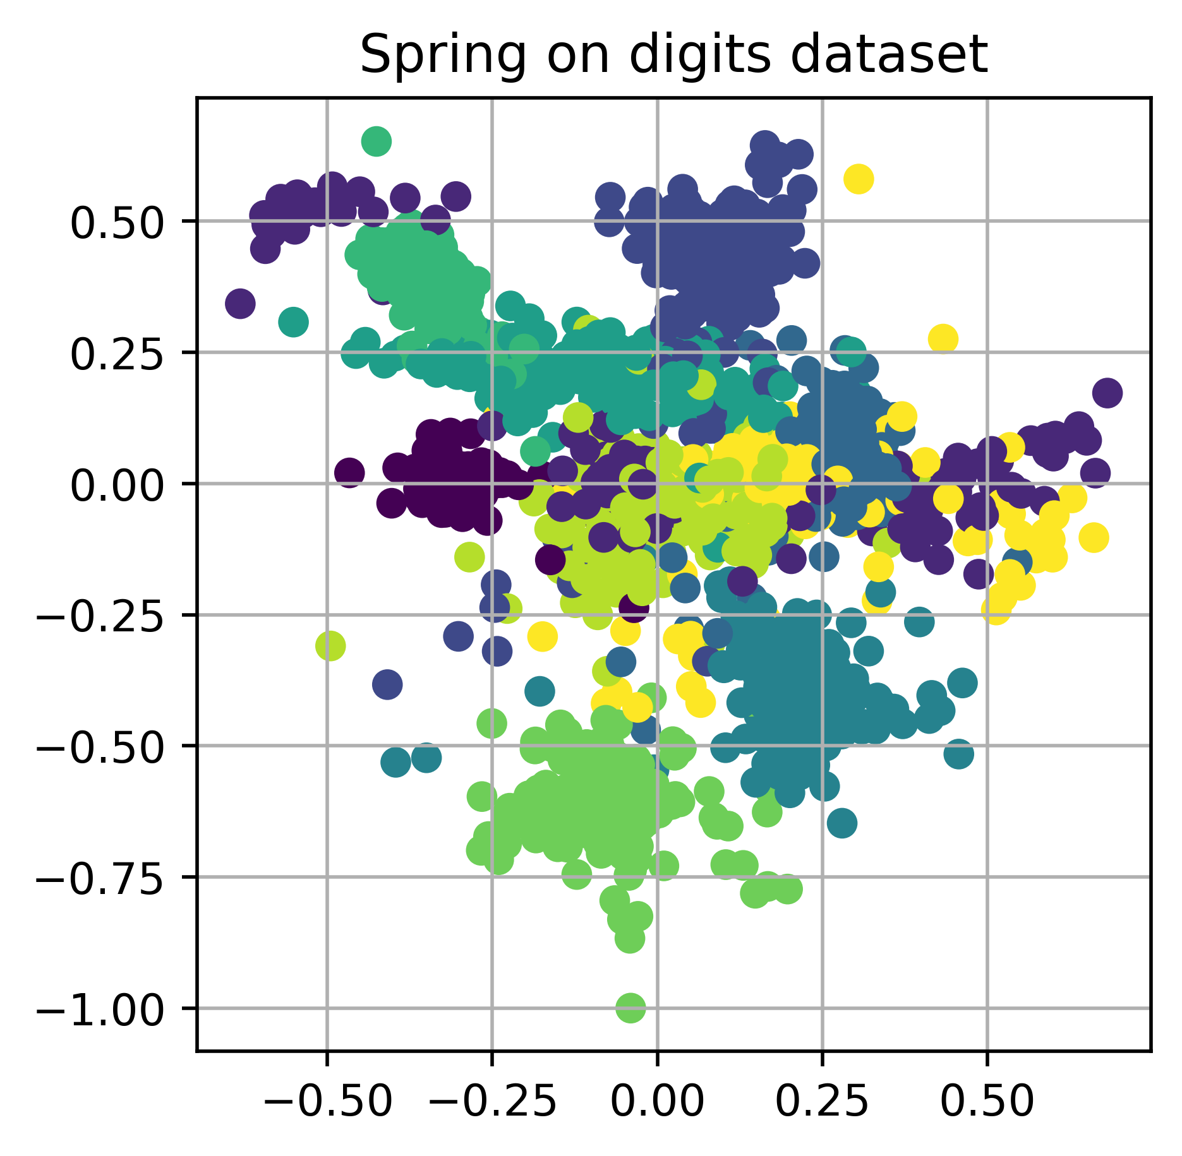
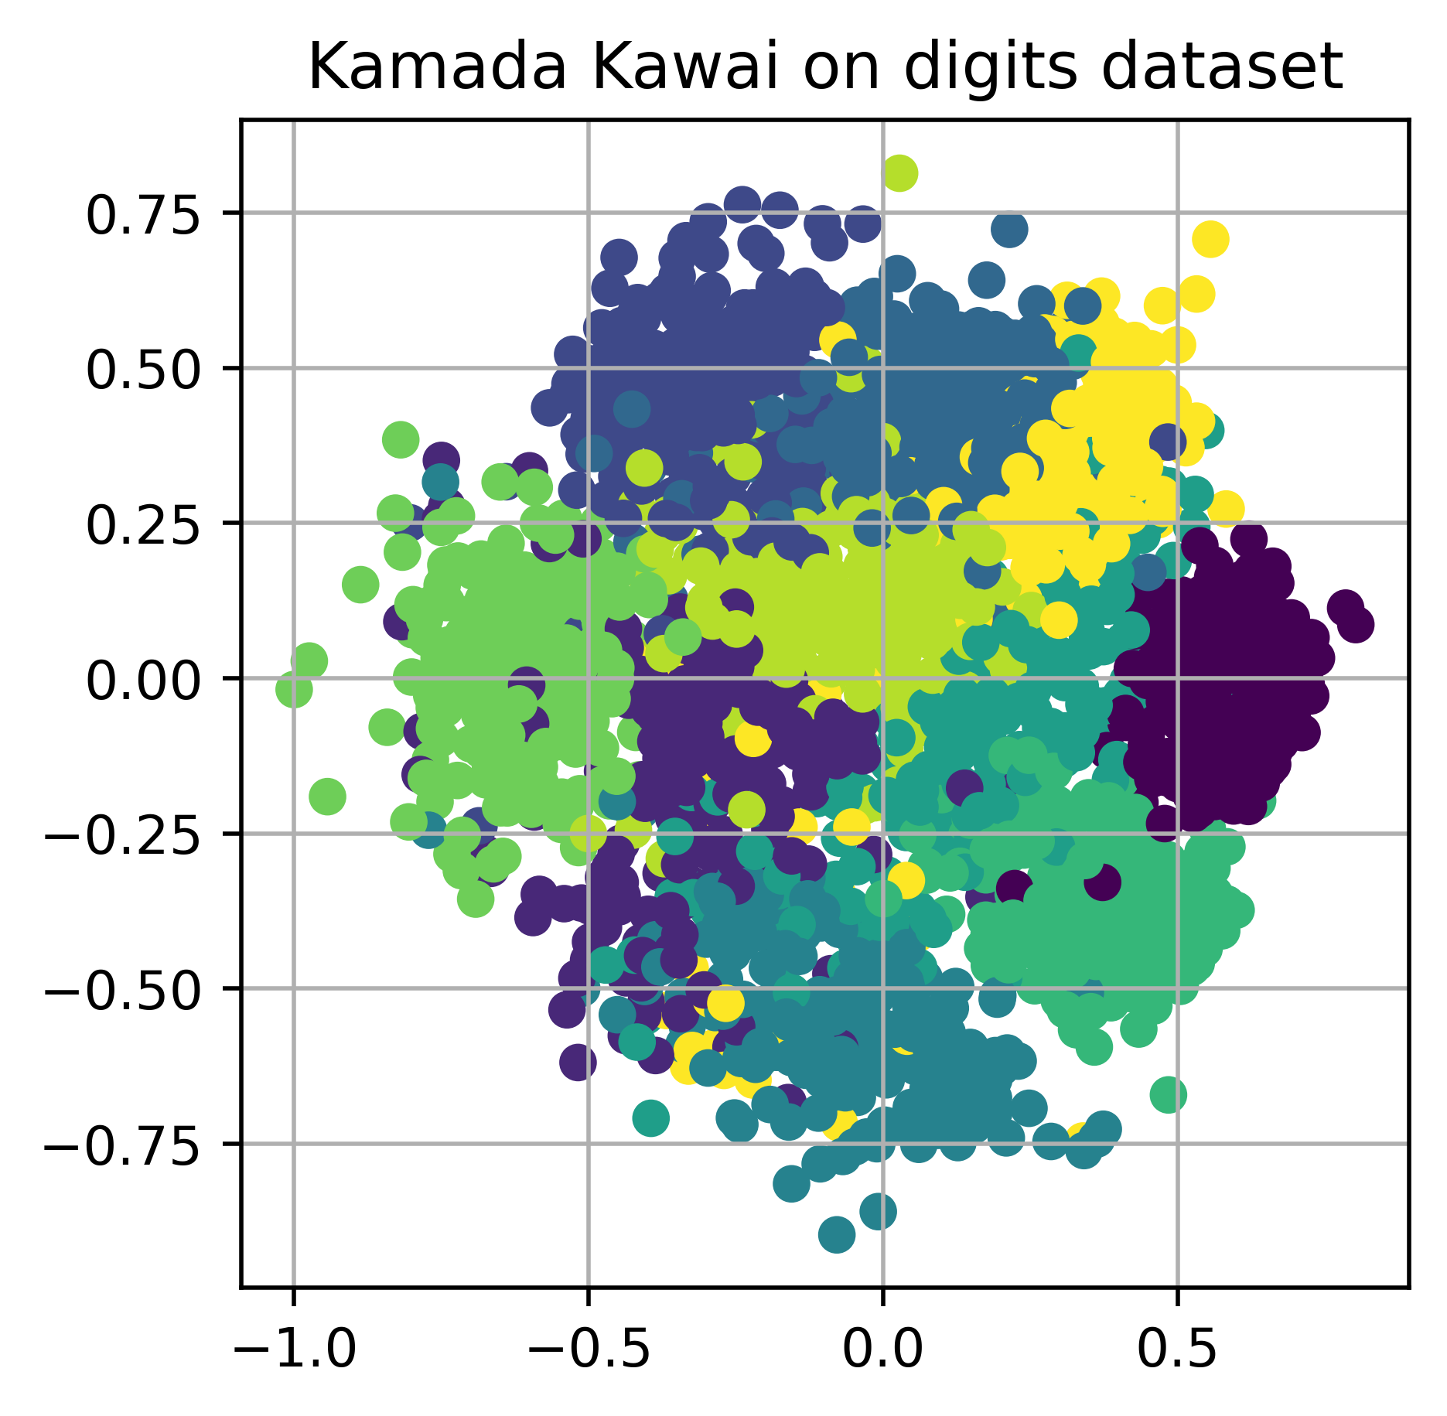
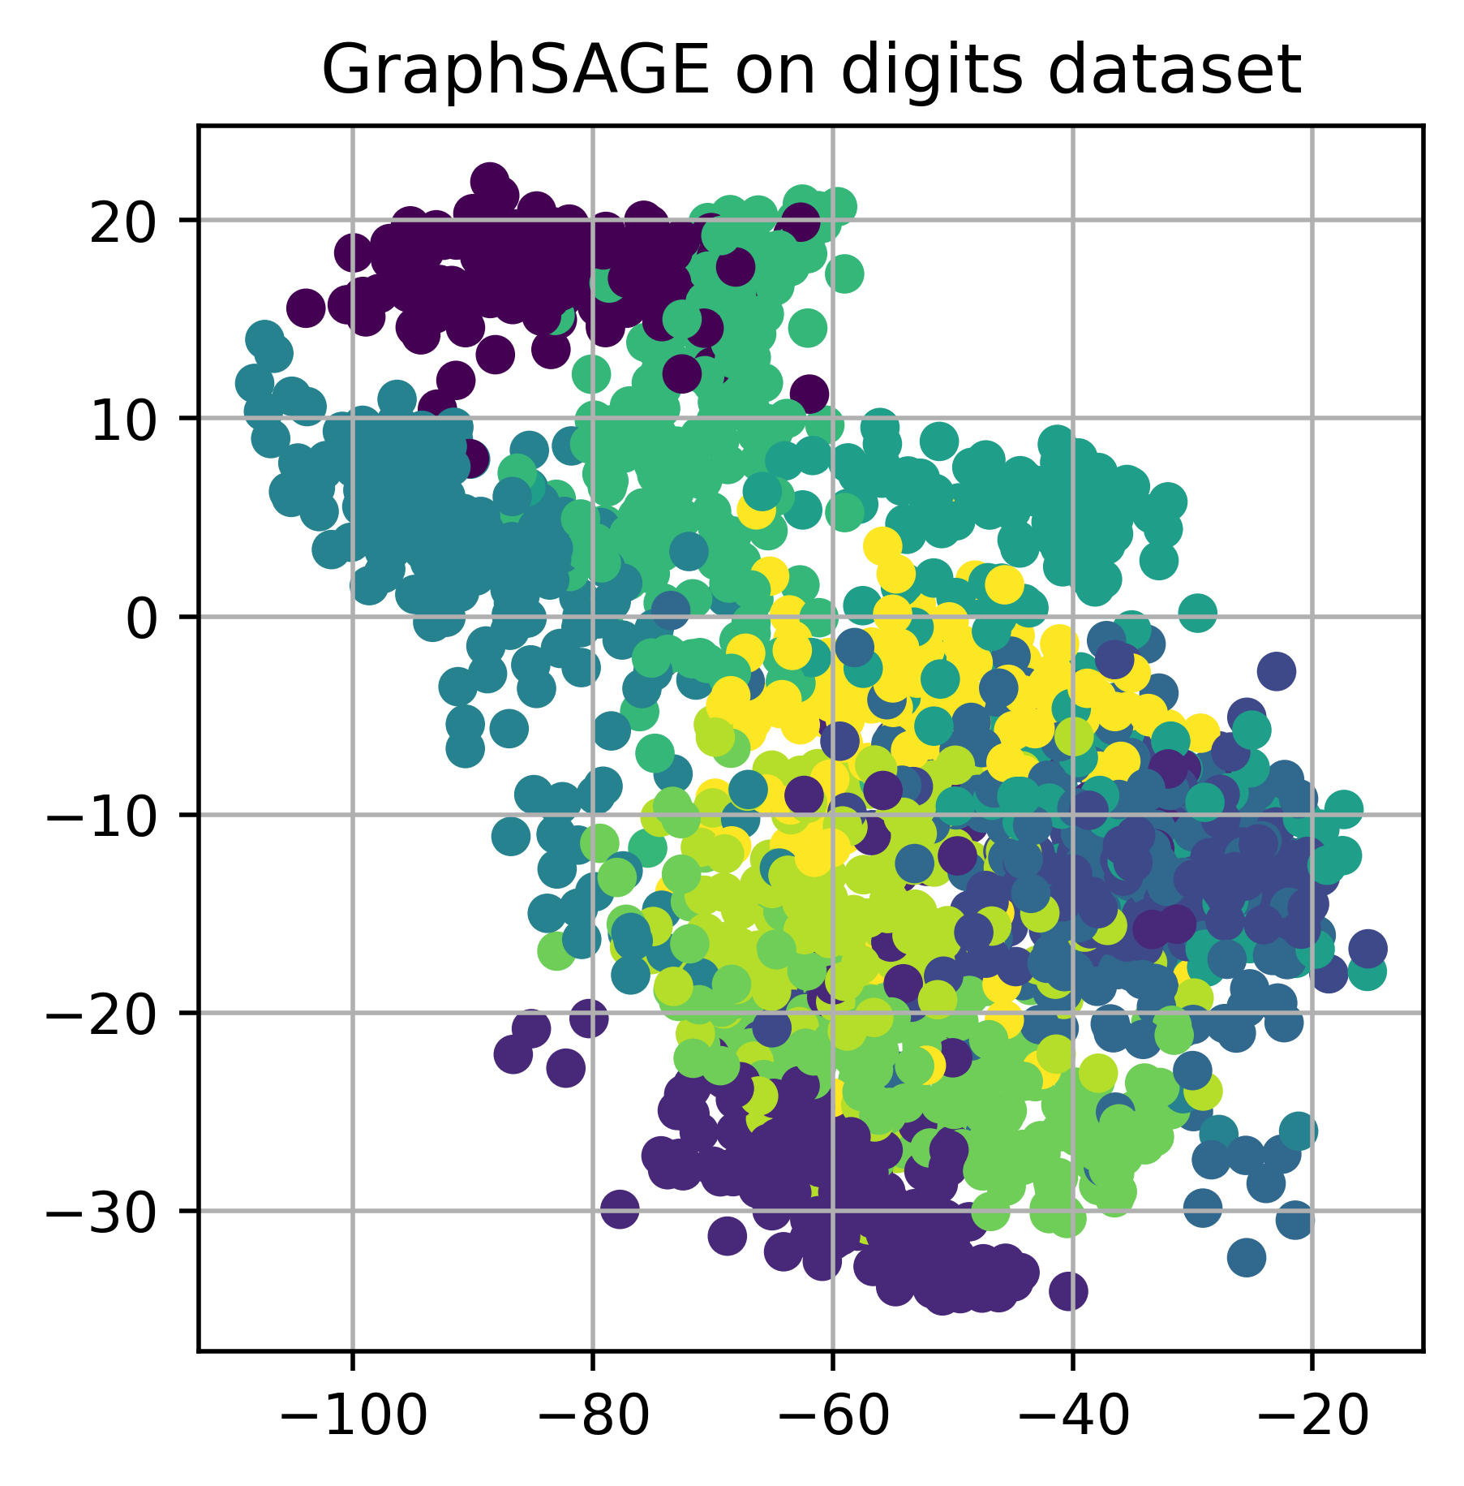
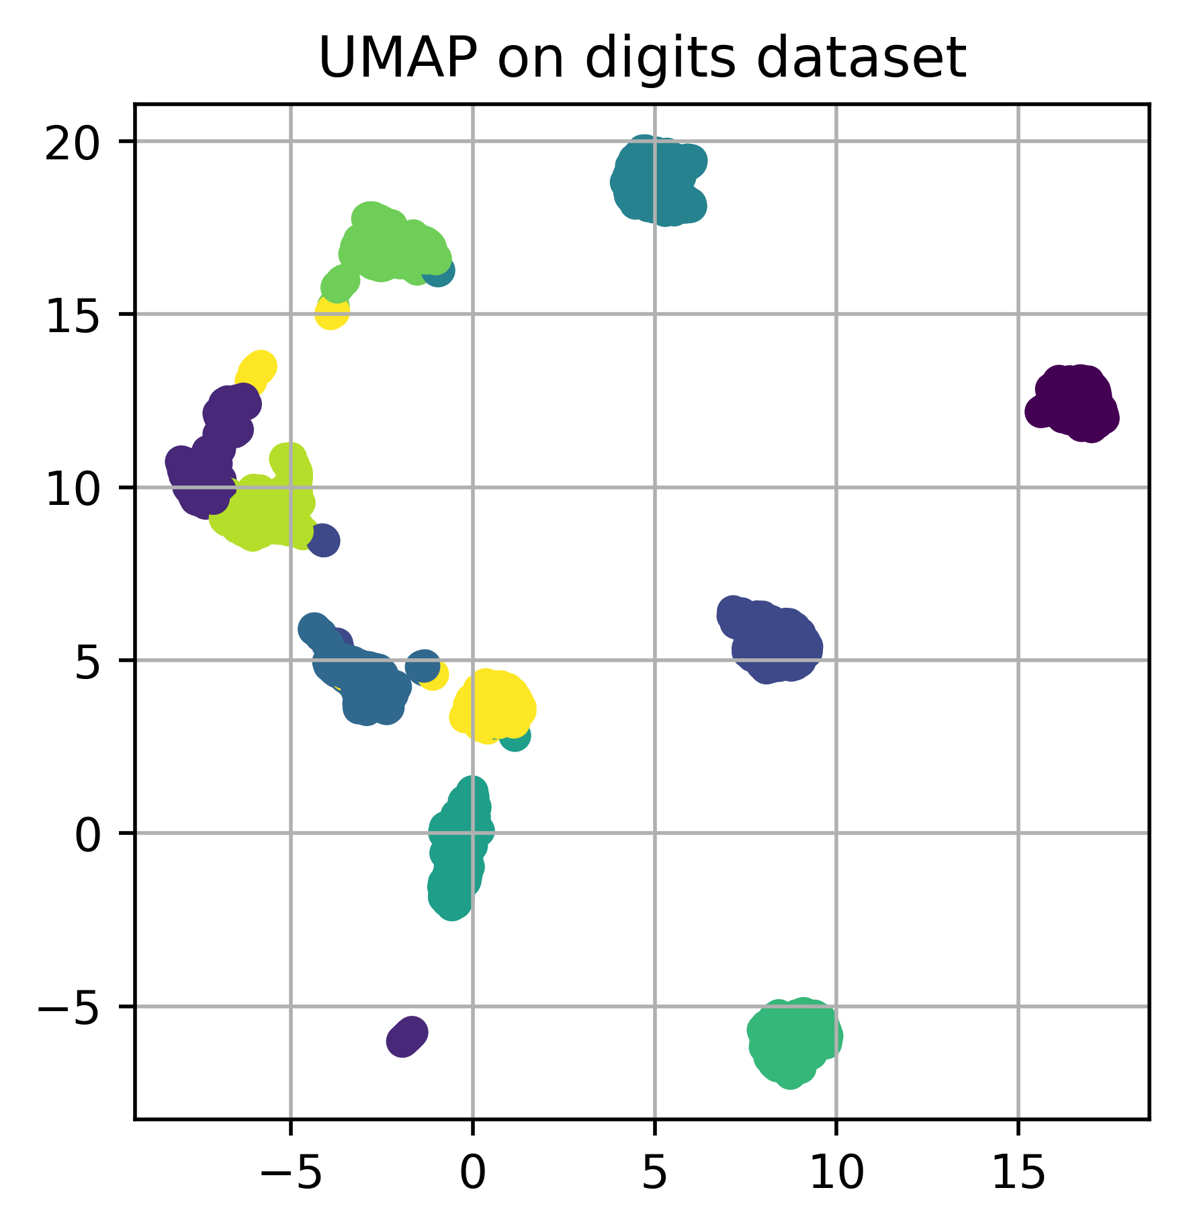
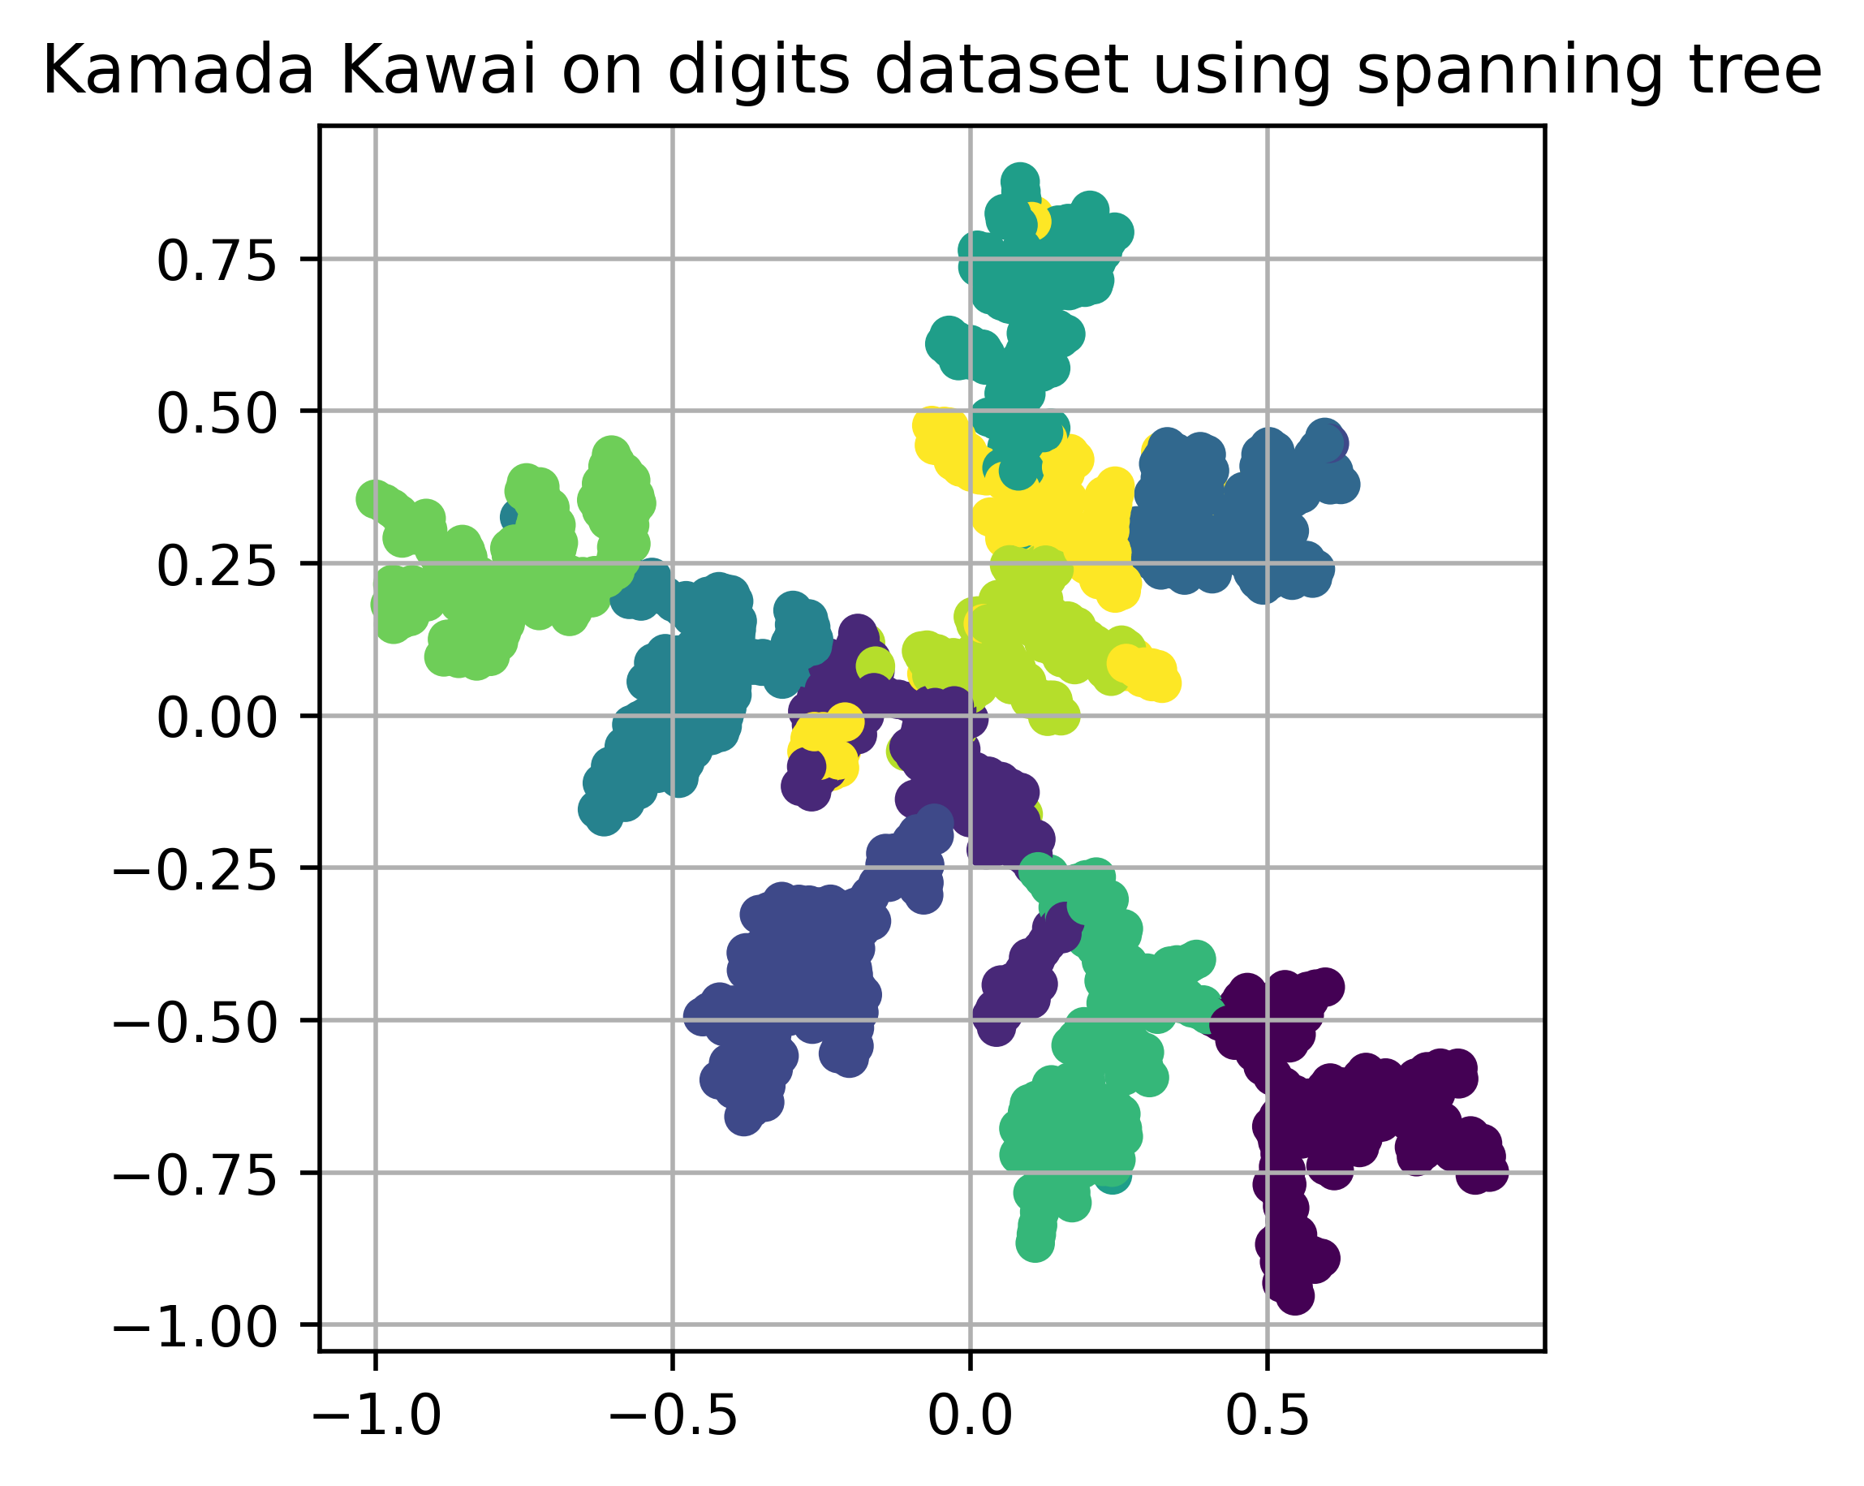

#19: Dimensionality reduction using graphs David Dobas, Jakub Rada, Theo Michel 20236035, 20236065, 20236005
CS471: Graph Machine Learning and Mining
KAIST
Problem statement
Our goal
Dimensionality reduction
Reduce dimension of data while preserving the structure of data, such as clustering or closeness of points
Can be used for
Visualisation (reduction to 2D or 3D)
Preprocessing for ML algorithms
State of the art algorithms
PCA – powerful and fast, cannot capture complex manifolds
UMAP, t-SNE – powerful and fast, complex to understand
Our research question
Can we capture the structure of data in graph?
Use graph as a compact representation of the data
Can be used to compress data
Can we use the obtained graph to reduce dimensionality?
We can use graph embedding methods
Advantages of our approach
Easy to understand algorithm
Able to capture complex manifolds
1
2
Graph building
Graph building – cheapest builder
Cheapest builder
Every datapoint is represented by node
We compute pairwise distances between all datapoints
Points with the shortest distances are connected by edges, edges added one by one until the graph is connected
Edge weights are added using the distances as
k is a hyperparameter
Spanning tree
We can use spanning tree, weights same as cheapest builder
$$w=\frac{1}{d^{k}}$$
3
4
Visual results
Visual results
Iris – 150 datapoints, dimensionality 4, 3 classes
Digits - 1797 datapoints, dimensionality 64, 10 classes
Can we unroll the Swiss roll?
How do the embeddings look
using spanning tree?
5
6
Quantitative results – digits dataset
Summary
Algorithm | Dimension | Trustworthiness | Continuity | Computation time
Cheapest + Spring | 2 | 0.9182 | 0.9784 | 1m 49.7s
Cheapest + Kamada Kawai | 2 | 0.8728 | 0.9661 | 8m 39.0s
Spanning + Kamada Kawai | 2 | 0.9875 | 0.9859 | 2m 5.0s
Cheapest + GraphSAGE | 2 | 0.8462 | 0.9530 | 34m 22.6s
PCA | 2 | 0.8591 | 0.9646 | 0.2s
UMAP | 2 | 0.9913 | 0.9927 | 7.2s
Cheapest + Kamada Kawai | 10 | 0.9949 | 0.9937 | 11m 8.1s
Spanning + Kamada Kawai | 10 | 0.9951 | 0.9867 | 57m 38.1s
Cheapest + GraphSAGE | 10 | 0.9611 | 0.9774 | 24m 40.5s
PCA | 10 | 0.9979 | 0.9990 | 0.3s
UMAP | 10 | 0.9961 | 0.9944 | 7.8s
We used simple algorithms for graph building and still obtained great results
Our algorithm is able to compete with state-of-the-art algorithms in terms of trustworthiness and continuity
However, we can not compete in computational time
Also, we use all pairwise distances, which is not feasible for big datasets
None of our methods is universally best on every dataset
That creates a room for improvements
7
8

